Slide 1


Final Year Project
Rethink Android Firewall and DNS Customization
Supervised By: Mr. Osama Raza (Sr. Lecturer)

Slide 2
Project Team
Abdul Muneeb Asif (29217)
Awais Tanveer (27663)
Saud Ur Rehman Abbasi (28561)

Slide 3
Table of Content
Background and Introduction
Literature Review
Problem Statement
Project Scope
Proposed Solution
  Requirements Summary
  Design Summary
  Methodology
  Implementation Summary
  Experiments and Results Summary
  Testing Summary
Conclusion and Outlook

Slide 4
BACKGROUND AND INTRODUCTION

Slide 5
Background and Introduction
Rethink DNS is an open-source, fast, secure, private, transparent, configurable DNS resolver and a firewall
This project enhances the Rethink with a Security Advisor, Root Detection, and a Virus Scanner to create a comprehensive security suite
These features offer advanced protection and control without requiring root access
The aim is to make mobile security accessible to all Android users

Slide 6
Literature Review

Slide 7
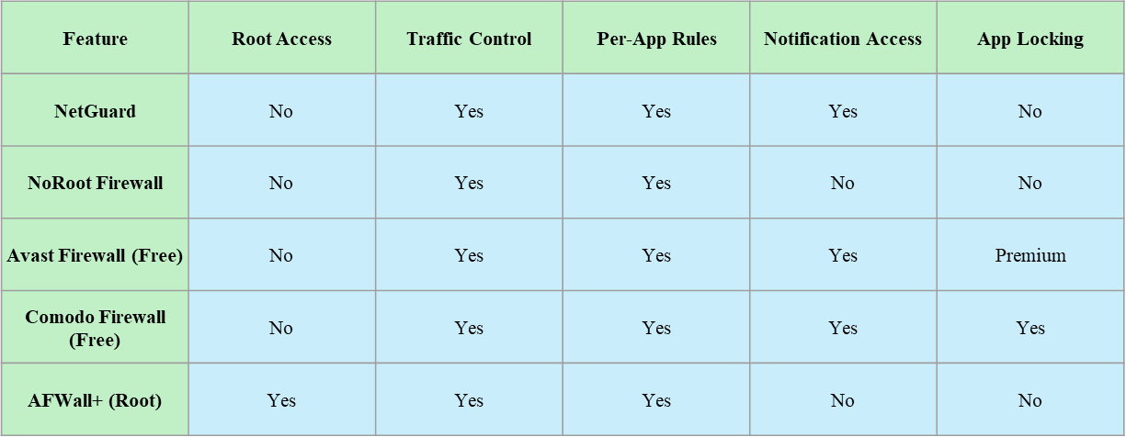
Literature Review

Slide 8
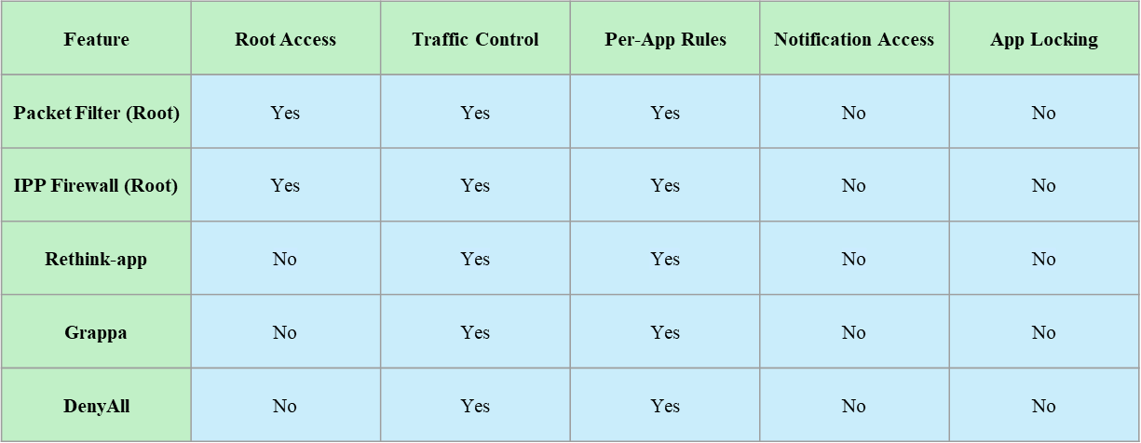
Cont’d

Slide 9
PROBLEM STATEMENT

Slide 10
Problem Statement
While Rethink-app offers a valuable firewall solution, users lack comprehensive security measures within the app:
Lack of essential security feature like Virus Scanner
Lack of Root Detection
Lack of Security Guidelines for non-technical user

Slide 11
ENDEAVOUR

Slide 12
Endeavour
Team Roles:
Project Manager: Awais Tanveer
Developer: Abdul Muneeb Asif
QA Engineer: Saud Ur Rehman Abbasi

Slide 13
Cont’d
Development Process:
Planning: Requirements gathering and sprint planning
Design: Modules Workflow and Sprints
Development: Modules development and integrations
Testing: Testing for quality assurance
Maintenance: Updates for performance

Slide 14
Cont’d
Team Collaboration:
Physical Meetings
GitHub
WhatsApp
Open communication and shared accountability

Slide 15
PROPOSED SOLUTION

Slide 16
Proposed Solution
This project proposes extending Rethink-app’s functionalities by integrating the following:
A security advisor that provides security advices to educate user about recent cyber threats and what security measures they can take to protect themselves online
Root detection to inform user about rooted device
An on-device virus scanner to detect malicious applications

Slide 17
Requirements Summary
Functional Requirements:
User shall be able to view security tips each time application is launched
System shall be able to check if the device is rooted or not
System shall perform a hash-based virus scan of the device’s installed packages using virus hash database

Slide 18
Cont’d
System Requirements:
Operating System: Android 9 or above
Language: Kotlin, XML
IDE: Android Studio
Processor: 2.0 Ghz Quad Core Cortex-A53 (similar or above)
RAM: 2GB or above
Storage: 16GB or above

Slide 19
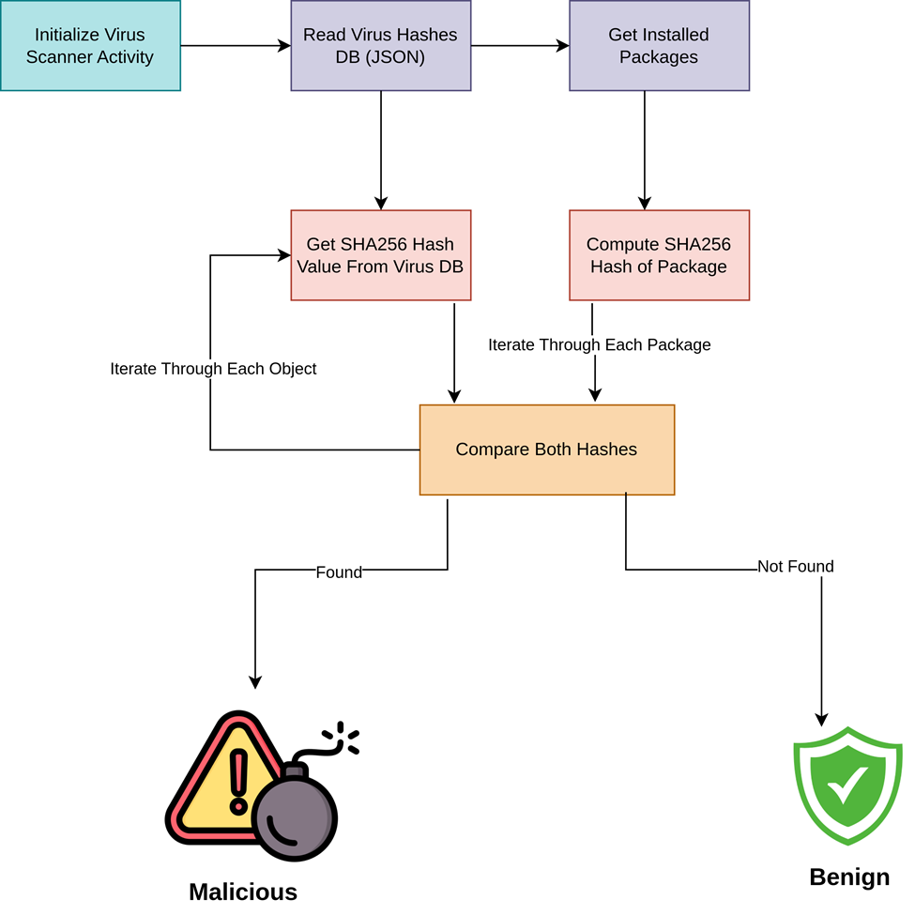
Design Summary (Virus Scanner Module)

Slide 20
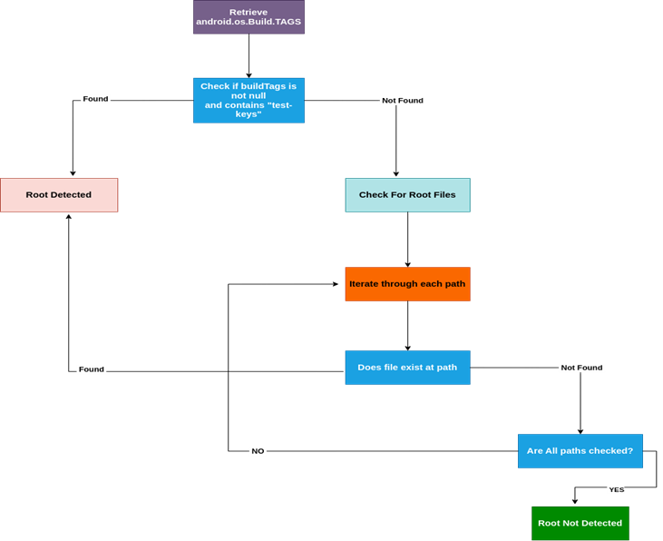
Design Summary (Root Detection Module)

Slide 21
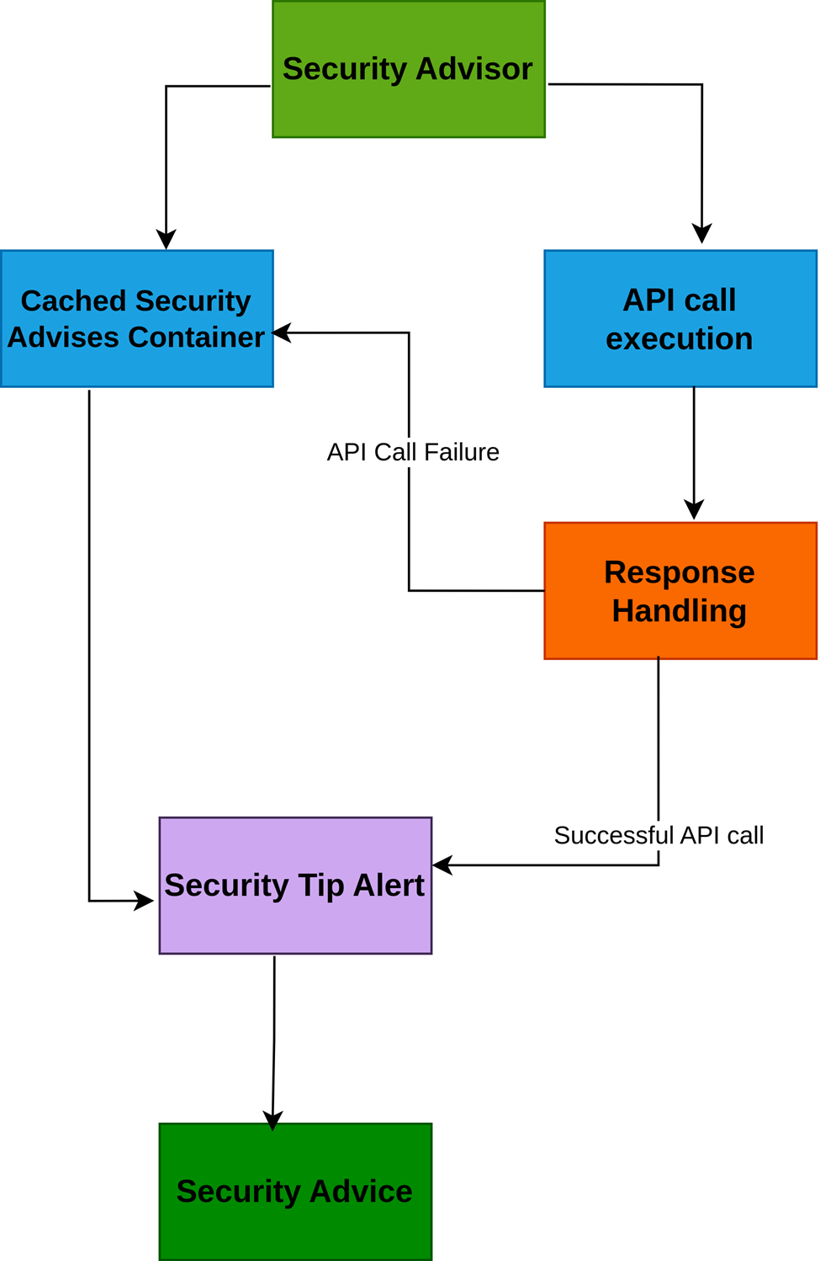
Design Summary (Security Advisor Module)

Slide 22
Methodology
The project adopts the following development approach:
Requirement Analysis: Refining the functionalities of each security feature
Module Development: Each module is developed ensuring compatibility with Rethink-app's architecture
Integration and Testing: Developed modules are integrated into Rethink app, followed by testing to ensure functionality and system stability
Evaluation: Testing results are used to evaluate and update the effectiveness of the implemented features

Slide 23
Implementation Summary
Module Development (Security Advisor):
Activities:
Develop security advisor module
Integrate with Rethink-app core
Deliverable:
Fully functional security advisor module integrated with the Rethink-app

Slide 24
Implementation Summary
Module Development (Root Detection):
Activities:
Develop root detection module
Implement user notification if root detected or not
Integrate with Rethink-app core
Deliverable:
Fully functional root detection module integrated with the Rethink-app

Slide 25
Implementation Summary
Module Development (Virus Scanner):
Activities:
Develop virus scanner module
Implement user notification for detected virus
Integrate with Rethink-app core
Deliverable:
Fully functional virus scanner module integrated with the Rethink-app

Slide 26
Experiments and Results Summary
Tested response time to fetch and display security tip (3 second on average)
Tested root detection on 5 Android devices (1 rooted, 4 non-rooted).
Tested virus scanner with a dataset of 100+ apps
Achieved accurate results in detection

Slide 27
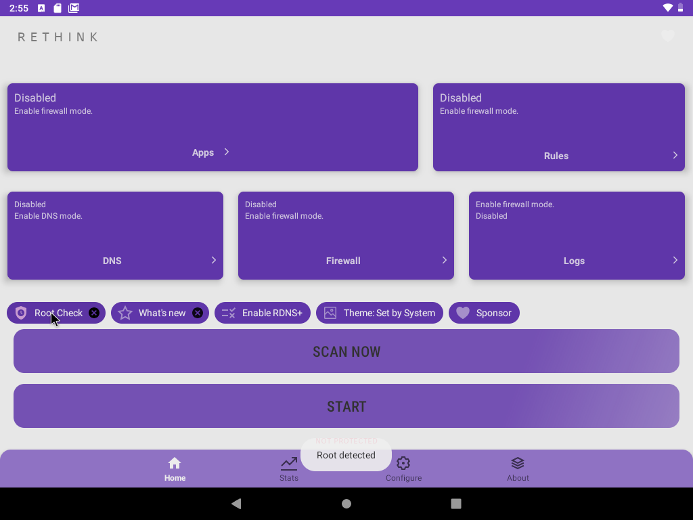
Testing Summary (Root Detection)

Slide 28
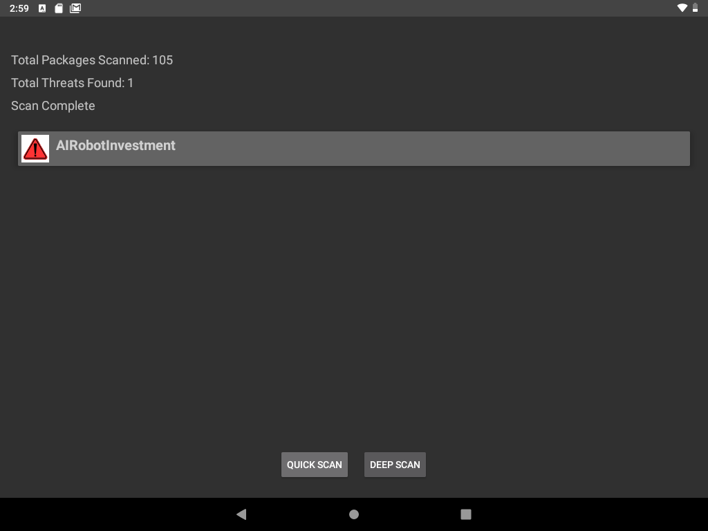
Testing Summary (Virus Scanner)

Slide 29
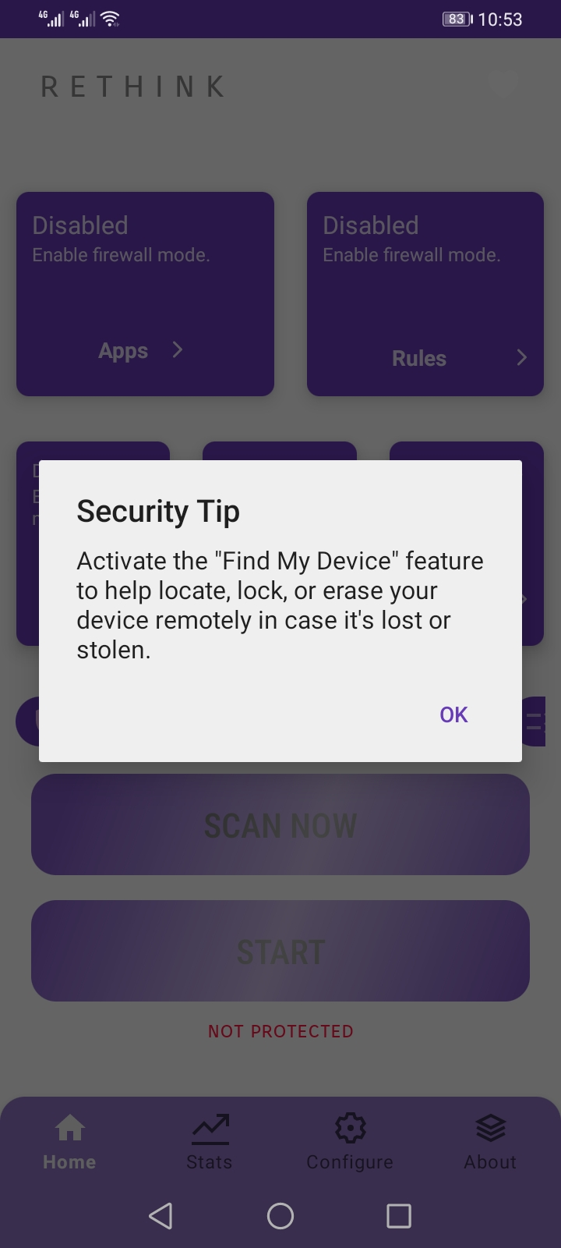
Testing Summary (Security Advisor)

Slide 30
CONCLUSION AND OUTLOOK

Slide 31
Conclusion & Outlook
This project successfully addresses key challenges in mobile security for Android devices by integrating three essential features into the Rethink-app, an open-source Android firewall.
The Security Advisor proved effective in raising user awareness about cyber threats and best practices for online safety.
The Root Detection mechanism empowered users to be informed if device is rooted.
The Virus Scanner performed effectively in detecting malicious applications.

